Slide 1

CSG1105 / CSG5130
Applied Communications
Chapter 21
Cryptography and Security

Slide 2
Objectives
Describe the differences between symmetric and asymmetric Encryption
Explain how encryption strength is based on key size and algorithm complexity
Discuss the different encryption algorithms used in networking and security
Describe the differences between encryption and hashing and their applications
Explain the purpose of steganography and what makes it possible

Slide 3
History of Cryptography and Security
As long as communication existed
  Need for secret communications existed
Cryptography
  Changing something easy (plain text) to read into something difficult to read
Encryption process
  Taking original information
  Coding it into a different, unreadable form
Decryption process
  Taking encrypted information
  Putting it back into original form

Slide 4
Symmetric Versus Asymmetric Encryption
Symmetric encryption
  Single key encrypts and decrypts data
Key
  Special word, phrase, or binary number
  Manipulates data during encryption or decryption
Asymmetric encryption
  Two keys used
    One encrypts data
    Another decrypts data

Slide 5
Symmetric Versus Asymmetric Encryption (cont’d.)
Symmetric encryption shares single key
  Encrypted data vulnerability
    Occurs if shared key falls into wrong hands
Asymmetric encryption keeps private key private
  Public key distributed to anyone needing it
  No damage if public key falls into wrong hands
    Public key used to encrypt data

Slide 6
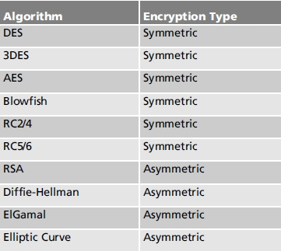
Symmetric Versus Asymmetric Encryption (cont’d.)
Table 21-1 Encryption Algorithms

Slide 7
Symmetric Versus Asymmetric Encryption (cont’d.)
Symmetric encryption algorithms
  Use one key for both encryption and decryption
    Special process used between parties to exchange key
    Key length determines data protection level
Asymmetric encryption algorithms
  Use two keys to perform encryption and decryption
    Mathematical makeup of keys allows each to decrypt data encrypted with other key
  Important capabilities not available with symmetric keys
    Digital certificates and digital signatures

Slide 8
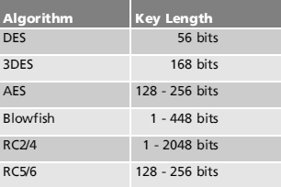
Symmetric Versus Asymmetric Encryption (cont’d.)
Table 21-2 Symmetric Encryption
Algorithm Key Length

Slide 9
Encryption Strength
Symmetric encryption algorithm
  Strength based on key size, and type of algorithm performing encryption
Asymmetric encryption algorithm
  Strength based on size of the prime numbers used to create key pair
    Based on special mathematical formula

Slide 10
Encryption Strength (cont’d.)
Caesar cipher
  Alphabet letters shifted one or more positions to obtain encryption alphabet
  Worst-case decryption scenario requires 25 different shifts
    25 equals 11001 in binary
    Encryption key: five bits in length

Slide 11
Encryption Strength (cont’d.)
Substitution method
  Encryption alphabet formed by writing secret key letters first
    Followed by remaining alphabet letters not used in secret key
  Share secret key
  Receiver constructs encryption alphabet and decodes secret message
  Gain insight into the substitution
    Look for double-letter pairs or frequency analysis

Slide 12

Encryption Strength (cont’d.)
Strength of substitution method
  Number of possible encryption alphabets
    26 factorial (26!) or 403291461126605635584000000
  Key size
    Binary bits representing 26!
    Number of bits required to represent the encryption key, given the number of possible alphabets (N):

Slide 13
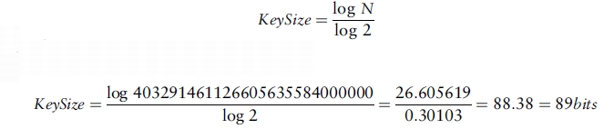
Encryption Strength (cont’d.)
Strength of substitution method (cont’d.)
  Key size (cont’d.)
    89 binary bits needed to represent number of possible alphabets
    403291461126605635584000000 keys available

Slide 14
Encryption Strength (cont’d.)
Strength of encryption method
  Influenced by encryption algorithm
Complex encryption method
  More secure
  Takes considerable resources to complete

Slide 15
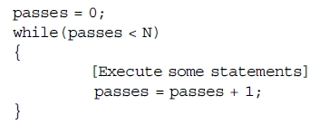
Encryption Strength (cont’d.)
Example: O(N) algorithm

Slide 16
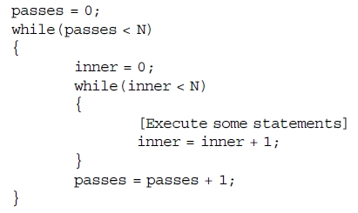
Encryption Strength (cont’d.)
Example: O(N²) algorithm

Slide 17
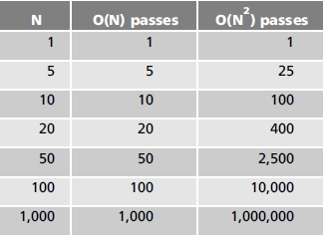
Encryption Strength (cont’d.)
Execution time
  Increases significantly for large values of N
Table 21-4 Comparing O(N) and O(N²) algorithms

Slide 18
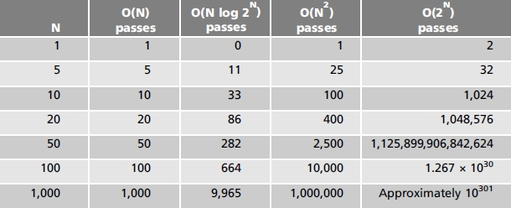
Encryption Strength (cont’d.)
Nature of algorithm design
  Requires consideration of other classifications
  Algorithms between O(N) and O(N²) have reasonable performance
Table 21-5 Performance of several different algorithm types

Slide 19
Encryption Algorithms
Symmetric or asymmetric
Block cipher algorithm
  Encrypts or decrypts blocks of data
    64-bit or 128-bit chunks of information at a time
Stream ciphers
  Encrypt any number of bits
Examining DES
  Illustrates block cipher algorithm

Slide 20
Encryption Versus Hashing
Encryption
  Data block changed into a different data block
Hash: computed representation of data
Hashing a data block
  Data not changed
  Hash value created
    Based on all data block information
  Used to check for data error
One-way hash
  Cannot unhash data and turn back into original form

Slide 21
Encryption Versus Hashing (cont’d.)
Password hashing
  Provides measure of privacy
  Safer way to store password compared to encryption
    Cannot be unhashed to learn original password
  User forgets logon password
    IT personnel cannot tell user their password
    IT personnel must inform user to change password to something new

Slide 22
Encryption Versus Hashing (cont’d.)
Digitally signing an email
  Verifies identity of person sending email
  Verifies email contents not changed during transit
  Accomplished by encryption and hashing combination
  Hash value called a digest
  Not the same as encrypting an email

Slide 23
Encryption Versus Hashing (cont’d.)
Hash algorithms
  Techniques to detect changes to information
  Methods to verify data integrity
    Ensuring original data not changed
  Performed independently on both sides
  Two popular hashing algorithms
    Secure Hash Algorithm (SHA)
    Message Digest (MD)
  Hashing process based on:
    Block of data taken in uniform chunks of data bits
    Stream of bits taken one at a time

Slide 24
Steganography
Technique for hiding one form of information inside another
Advantages (also disadvantages)
  Not obvious that anything is hidden
  Do not know where or how something is hidden
Steganography applications freely available
  Can hide practically any file type inside any other file type
Password or pass phrase required to extract hidden information
Different from watermarking

Slide 25
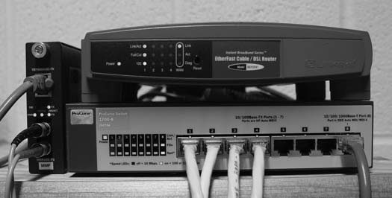

Steganography (cont’d.)
Colors look essentially the same to the naked eye
Comparing the Red, Blue, Green color channels of the images shows many differences
Figure 21-5(b) JPG image with
hidden 36 KB C program
Figure 21-5(a) Original JPG image

Slide 26
Steganography (cont’d.)
Hiding information inside a WAV file
  Simple technique
    Every sixteen samples, sample set least significant bit set to 0 or 1 value
    According to data being inserted into the file
  128-byte block: adjust LSB of eight samples
    Spreading out changes reduces chance audio affected
    Changing sample LSB only means the smallest possible effect made to the sample
  WAV file size determines how much data can be hidden inside it
    One data byte hidden inside every 128-byte block

Slide 27
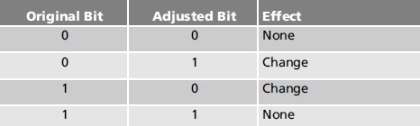
Steganography (cont’d.)
Hiding information inside a WAV File (cont’d.)
Table 21-7 How the LSB is affected when hiding data

Slide 28
Steganography (cont’d.)
Hiding information inside a JPG image
  Pixel-to-DCT relationship important to understand
  DCT coefficients changed when information hidden inside JPG image
    Adjusts the LSB of certain coefficients
  Example: pixel result when changing the DC coefficient located at DCT (0,0)
    Increase DC coefficient: all pixel values increase
    Decrease DC coefficient: all pixel values decrease
    Very little change to DC coefficient: pixel intensity change not noticeable (information hidden without detection by the naked eye)

Slide 29
Troubleshooting Techniques
Working with complex encryption systems
  Requires patience, good understanding of system requirements
An email investigation
  Verify email encryption configurations
Testing a VPN connection
  Try different encryption and hashing combinations
    Use small and large file sizes
Sometimes, you just have to guess
  Use a best educated guess to solve problem

Slide 30
Summary
Encryption: putting data into a different form
Decryption: putting data back into its original form
Encryption forms: symmetric and asymmetric
Hashing technique detects changes to information
  Digest: hash value of an email
  Verifies data integrity
Steganography: technique for hiding one form of information inside another
  Different from watermarking
  File size determines data amount that can be hidden

